Slide 1
Develop Universal
Windows Apps
on Windows 10
Ashish Sahu
Aparna Chinya
Windows AppConsult Engineer

Slide 2
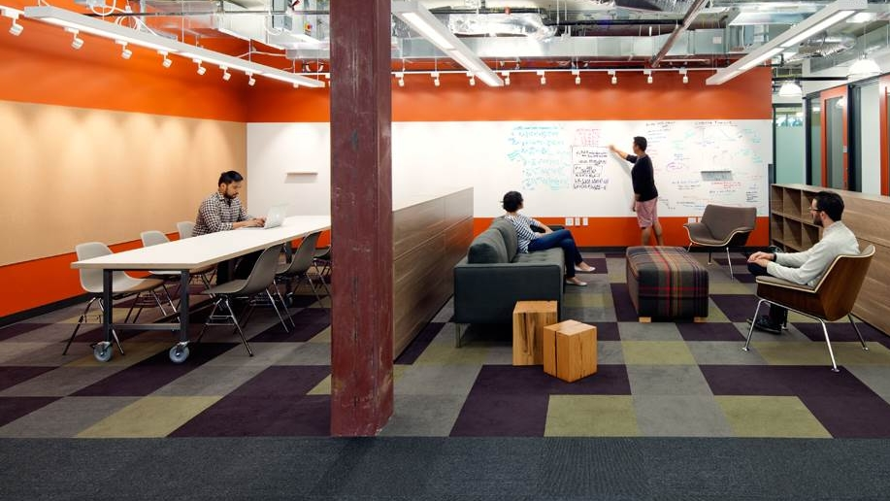
Agenda
Developing Adaptive Code for UWP Apps
Designing Adaptive UI and tailored design
Delighting the users
Bring your app alive with Cortana Voice Commands
Build connected apps with roaming application data
http://aka.ms/labsample

Slide 3
Agenda
Developing Adaptive Code for UWP Apps
Designing Adaptive UI and tailored design
Delighting the users
Bring your app alive with Cortana Voice Commands
Build connected apps with roaming application data

Slide 4
Developing Adaptive Code for UWP Apps
Getting started with Universal Windows Apps
Extension SDKs
Lab

Slide 5
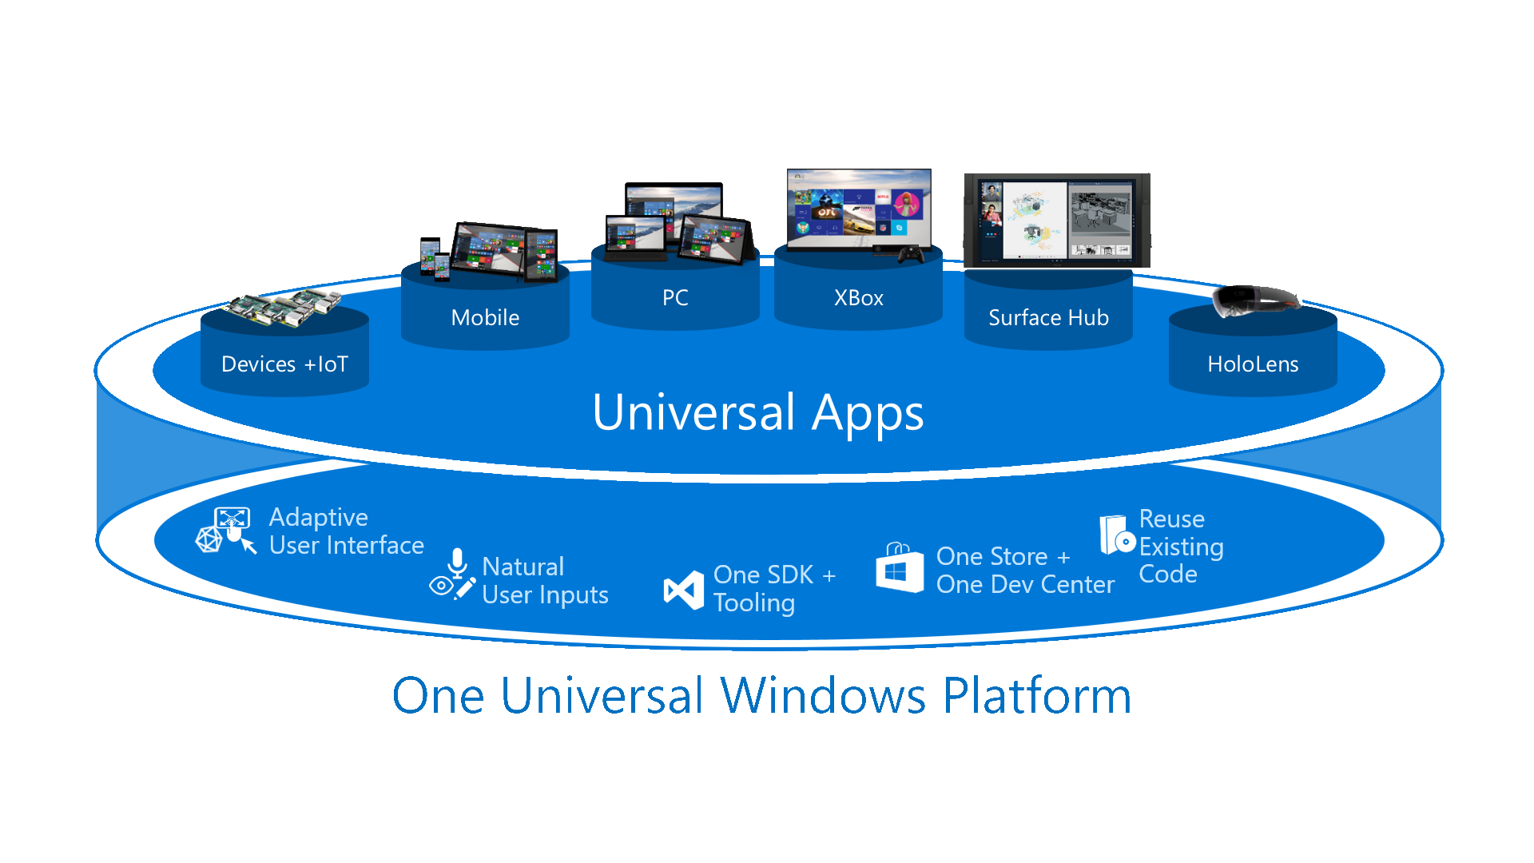

Slide 6
One Windows
Desktop family
Mobile family
Xbox family
IoT family
IoT headless family
Surface Hub family
Holographic family
PC
2 in 1
Tablet
Phablet
Phone
Xbox
Band
Raspberry Pi
Surface Hub
HoloLens
Home Automation
Band 2

Slide 7
Designing Adaptive UI and tailored design
Visual States
Adaptive Triggers
RelativePanel
Lab

Slide 8
Physical Pixel
Effective Pixel

Slide 9
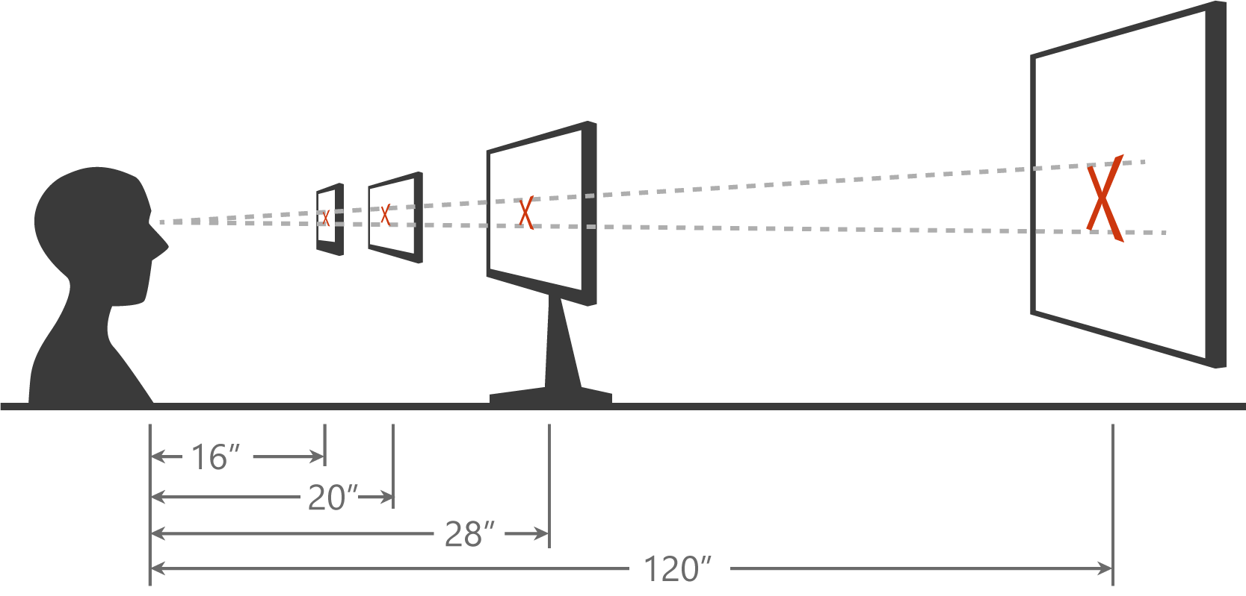

Slide 10
Delighting the users
Adaptive Tiles
Toast Notifications
Interactive Toasts
Background Tasks & Background transfers
Share Contracts
Context Menu
Lab

Slide 11
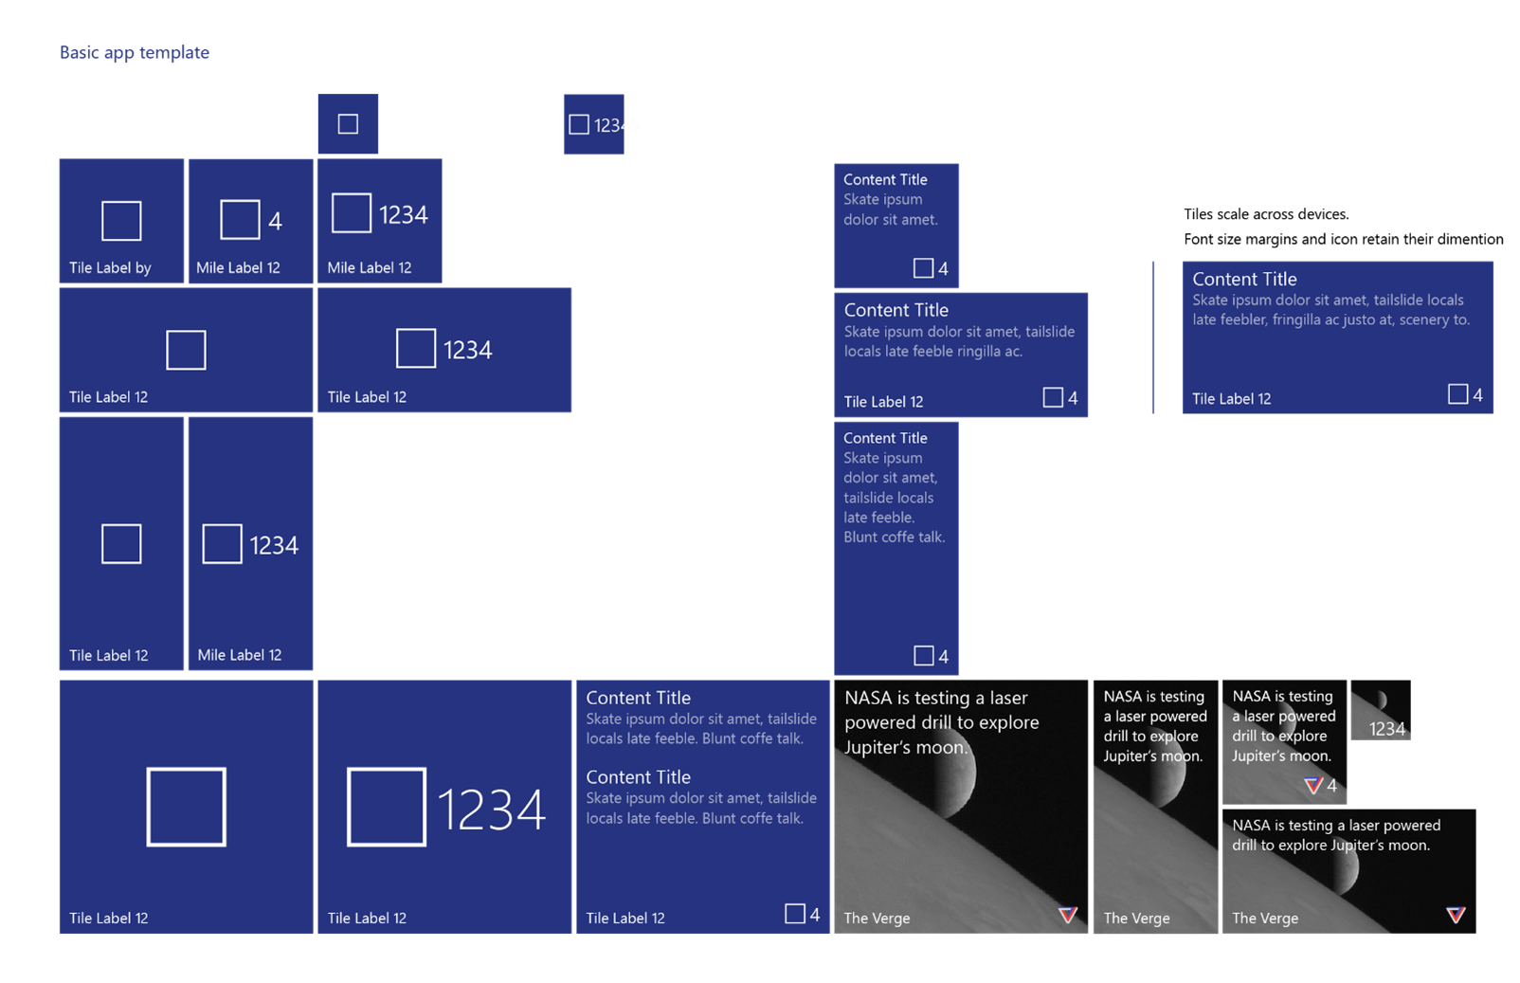

Slide 12






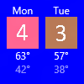










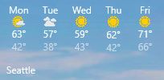




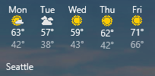





Slide 13
Cortana Voice Commands
Cortana is everywhere
Lab

Slide 14
One Windows
Desktop family
Mobile family
Xbox family
IoT family
IoT headless family
Surface Hub family
Holographic family
PC
2 in 1
Tablet
Phablet
Phone
Xbox
Band
Raspberry Pi
Surface Hub
HoloLens
Home Automation
Band 2

Slide 15


References
Related references for you to expand your knowledge on the subject
<Quote related references here>
technet.microsoft.com/en-in
aka.ms/mva
msdn.microsoft.com/
Developer Network

Slide 16

< QR Code will be given 2 days before the Conference >
Tell us what you think
Help us shape future events by sharing your valuable feedback.
Scan the QR code to evaluate this session.

Slide 17

Thank you
Follow us online
Twitter:
@aparnachinya
Email: appconsultindia@microsoft.com

